Slide 1
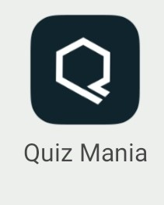
QUIZMANIA
Icon of the app

Slide 2
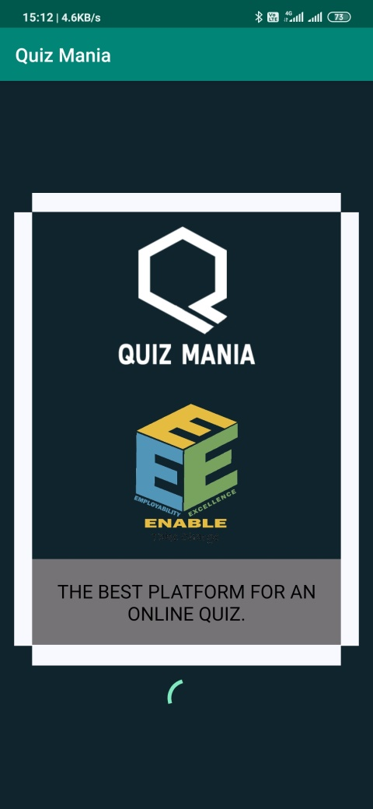
Welcome Page
This is the welcome screen which appears as the Application gets started.

Slide 3
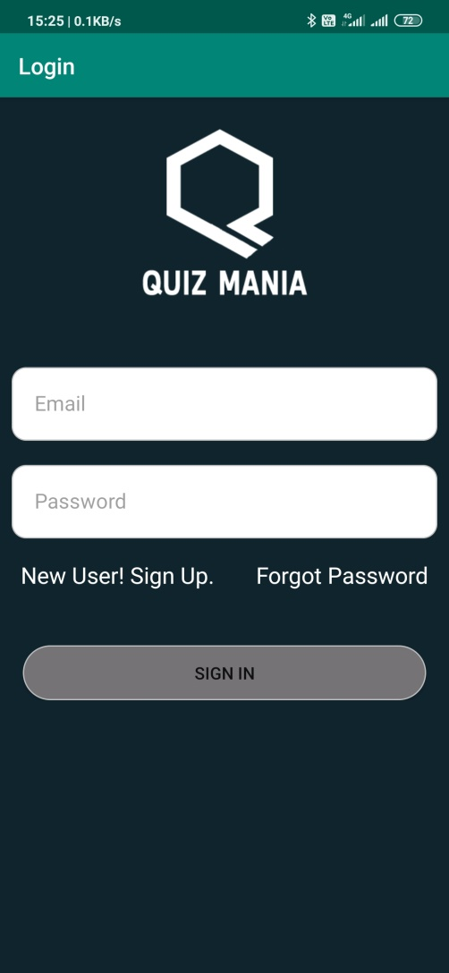
Login Page
This page allows the User to login.
Only existing Users are can log in through this page.

Slide 4
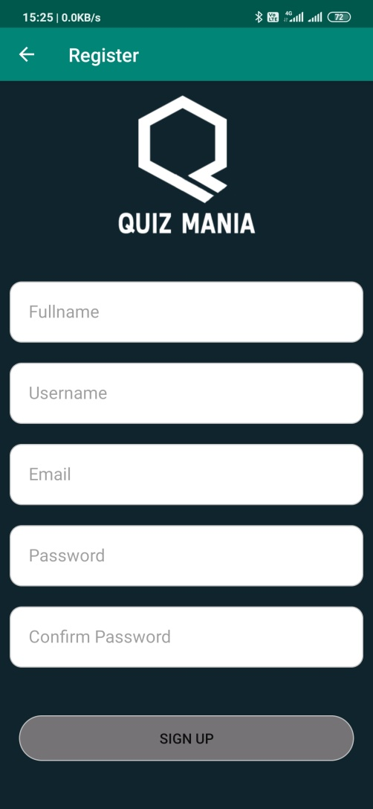
Register
This is the registration page of the user.
As the user register a verification email is sent to the email provided by the user.

Slide 5
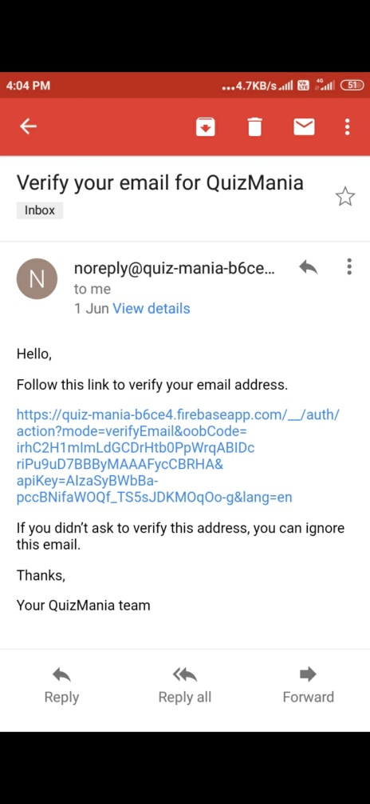
Verification E-Mail
This the verification email which will be sent to the user.
User can simply click on the link to verify the email. As the email gets verified the user can login through the login screen.

Slide 6
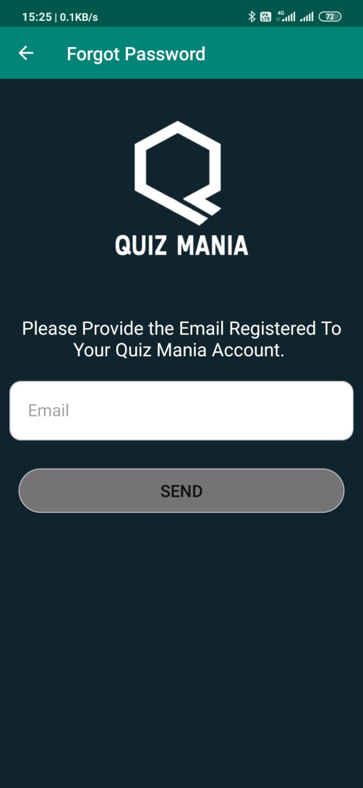
Forgot Password
This page appears when the user opts for Forgot Password which allows the user to change the password just by clicking a link sent on the registered email given by the user.

Slide 7
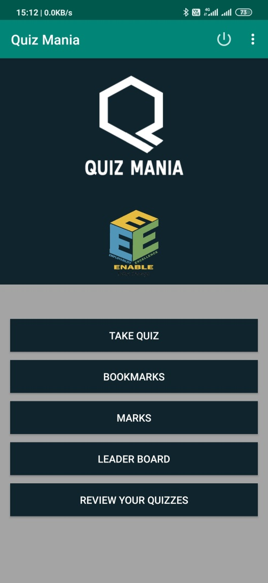
Main Page
This page allows the user to choose between various options.
It is the first page that appears after Login/Signup Procedure.

Slide 8
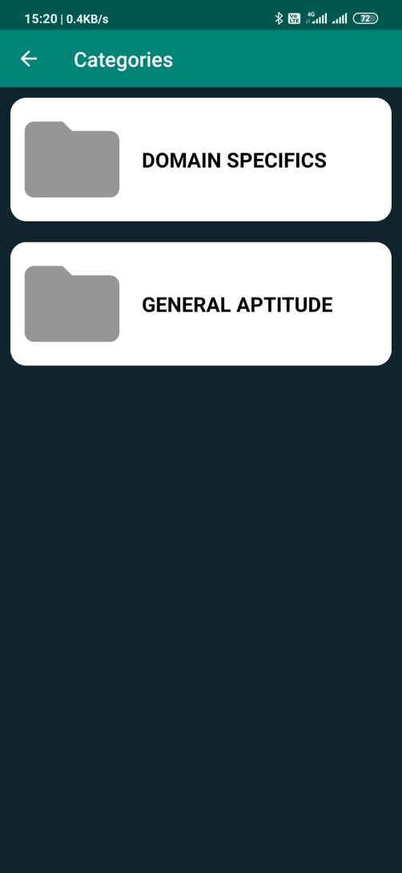
Take Quiz
This page appears when the user opts for Take Quiz option.
It allows the user to choose between different categories.

Slide 9
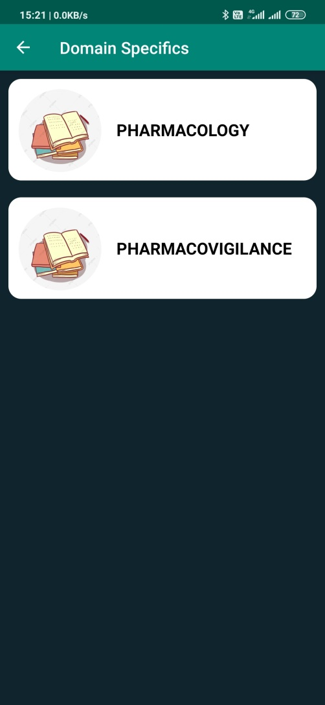
Categories/Topics
This page displays the topics of the chosen directory.

Slide 10
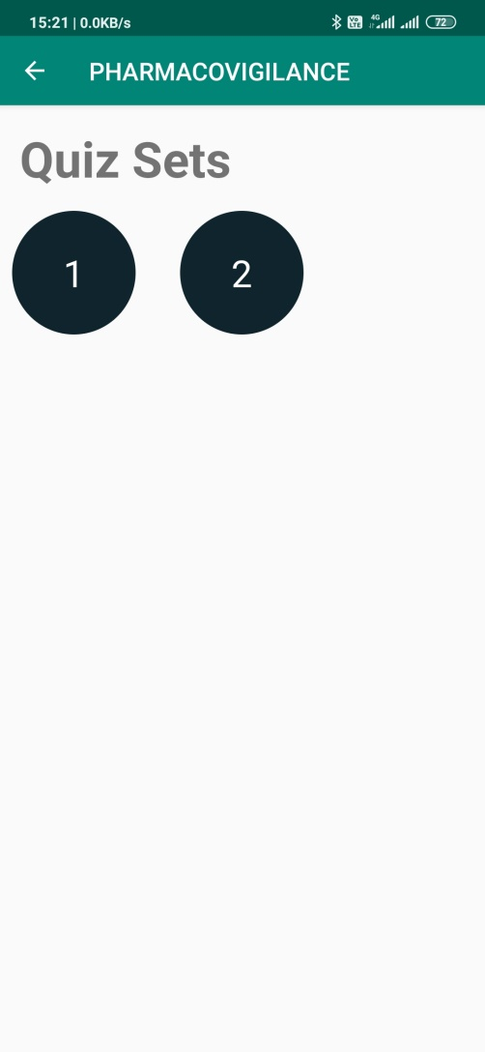
Quiz Set
This page displays the different quiz sets of the chosen topic.
The user can select a particular quiz set to give the quiz.

Slide 11
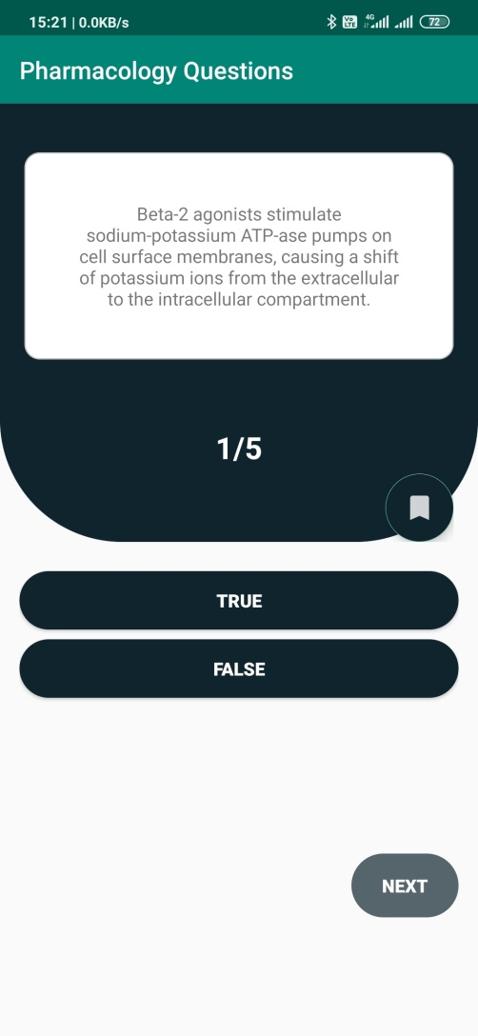
Take Quiz
As the quiz gets started this page will be displayed having different options.
If the user selects the right answer the selected option will turn green.
And if the user selects the wrong answer the selected option turns red and correct answer will turn green.

Slide 12
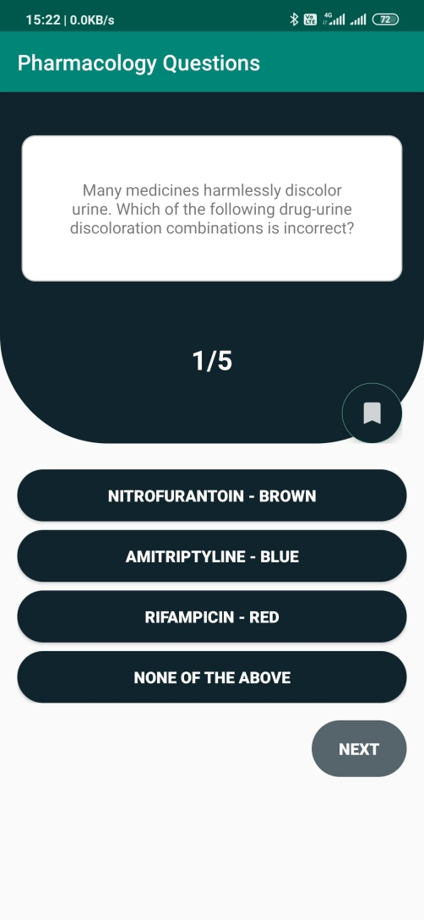
Take Quiz
Next button will only be enabled after the user chooses one of the options.
User can bookmark the questions to view it later.
This is the page of a 4 options question.

Slide 13
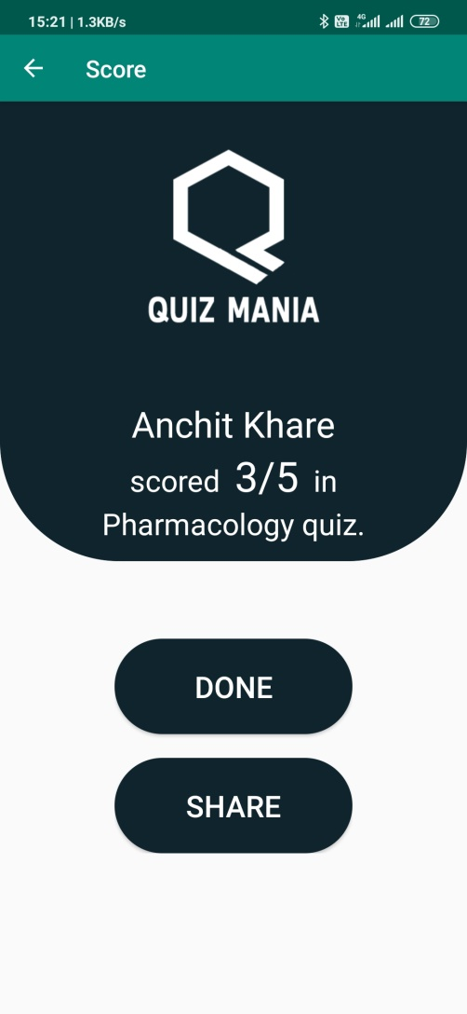
Score
As the quiz gets completed the score screen will be displayed.
The score will be noted only in the first attempt of the quiz.
User can share the score by clicking on the share button.

Slide 14
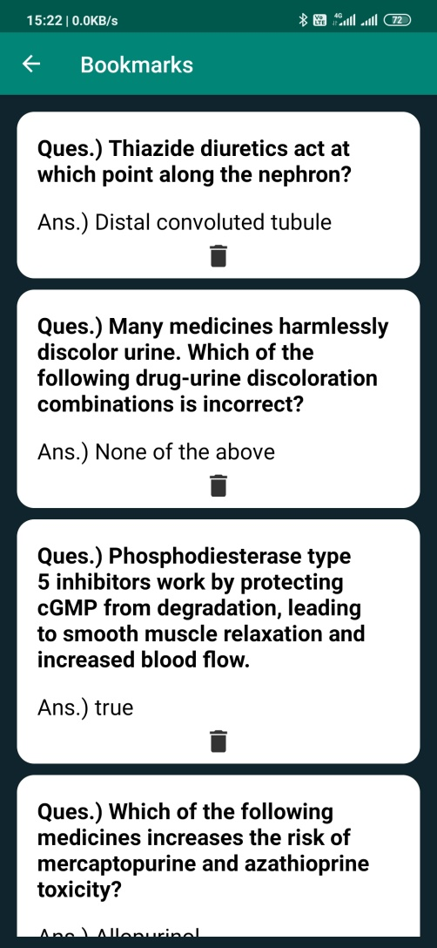
Bookmarks
This page appears when the user clicks on the bookmark option.
Bookmarked questions can also be deleted by clicking on that delete button.

Slide 15
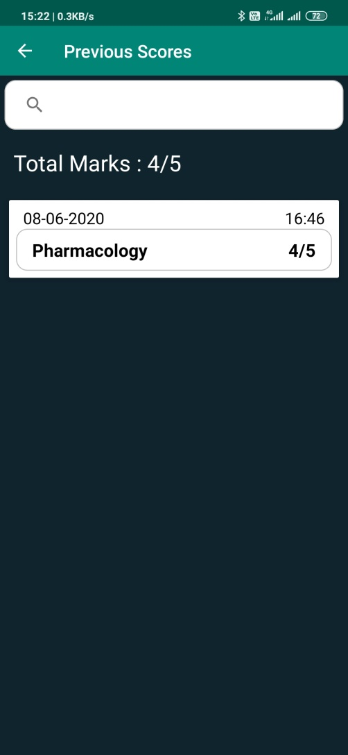
Previous Score
This page displays the previous scores of the user with it’s date and time.
It will display the scores of the first attempt of the quiz.

Slide 16
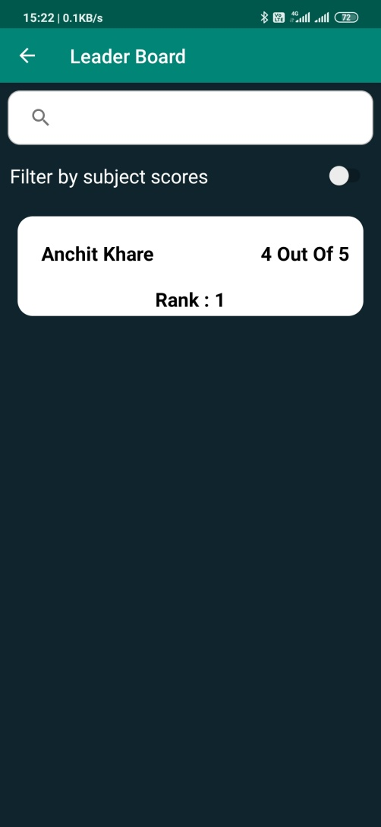
Leader Board
This page shows the overall leader board of the students.
It shows all the students with their top scores.

Slide 17
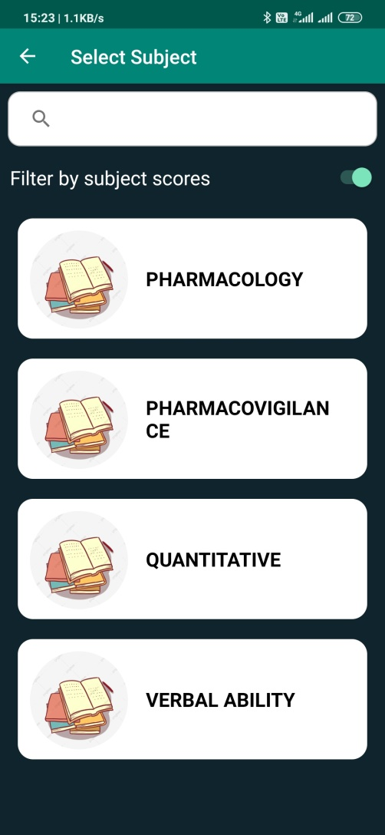
Leader Board
This is the subject leader board which allows the user to view the leaders of a particular subject or topic.

Slide 18
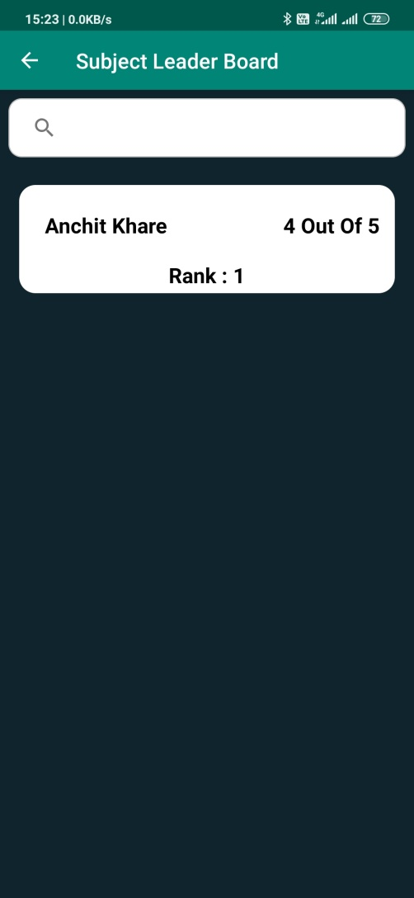
Leader Board cont.
This page appears when a Subject is selected.
It shows all the leaders of that particular subject.

Slide 19
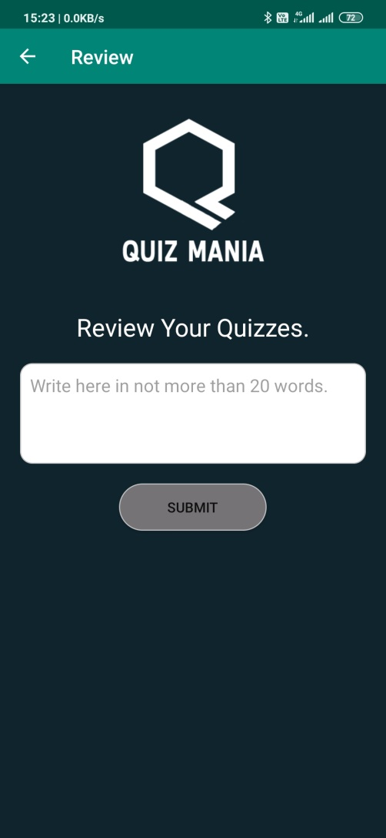
Review
User can submit the review of the quizzes in less than 20 words.

Slide 20
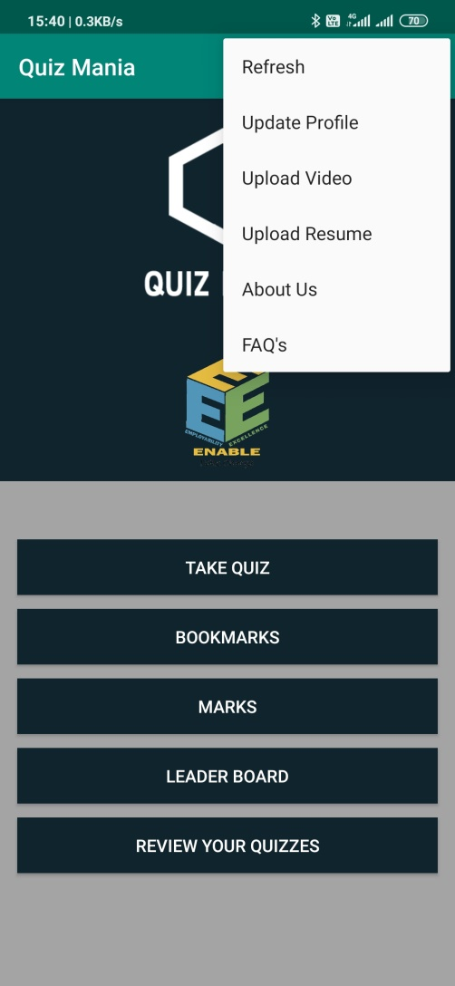
Menu Buttons
User can select for different options by clicking on menu button placed at the top right corner of the homepage.

Slide 21
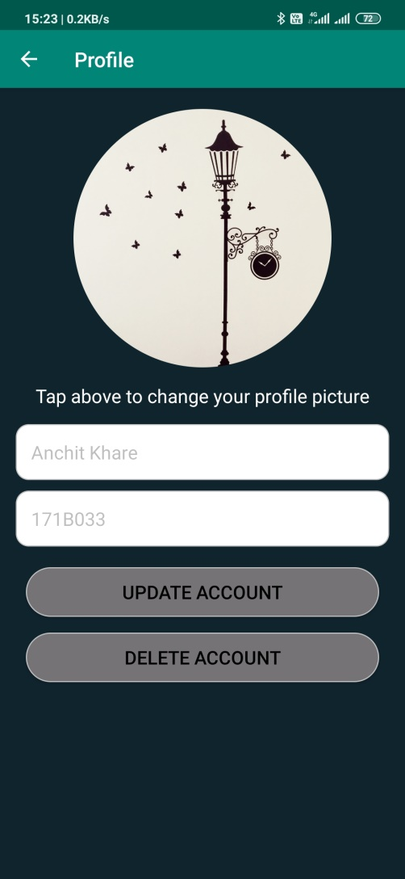
Update Profile
User can update his/her profile picture by clicking on the circular image.
The picture can also be deleted by holding the image for a bit time.
User can make changes or delete the account as per his/her needs.

Slide 22
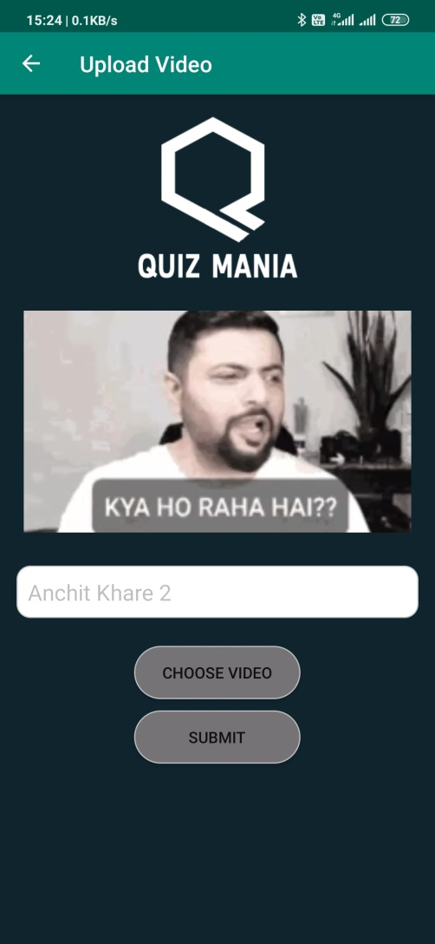
Videos
User can upload a video file with a suitable video name.
Application has an inbuilt video player for an ease.

Slide 23
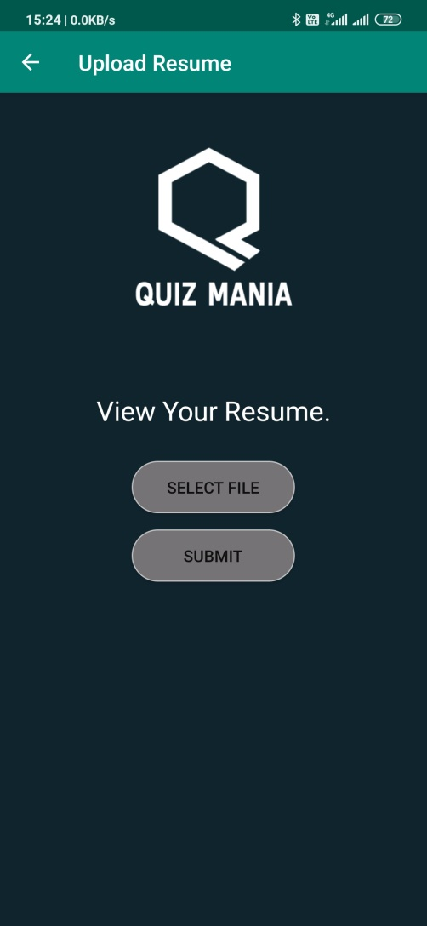
Resume
User can upload its resume by first selecting the file and then Submitting it.
Resume can be viewed by clicking on “View your Resume” text.

Slide 24
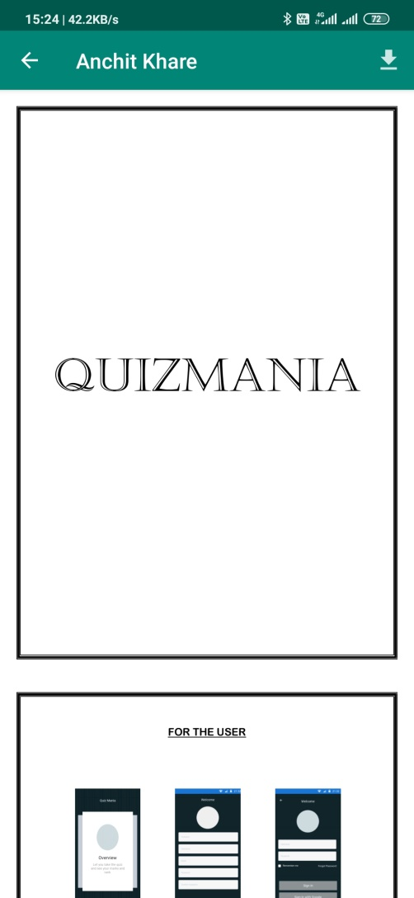
Resume
Application has an inbuilt PDF viewer.
The user resume can be viewed from the app itself no need for an external pdf viewer.
Resume can also be downloaded by clicking on the download button present at the top right corner of the app.

Slide 25
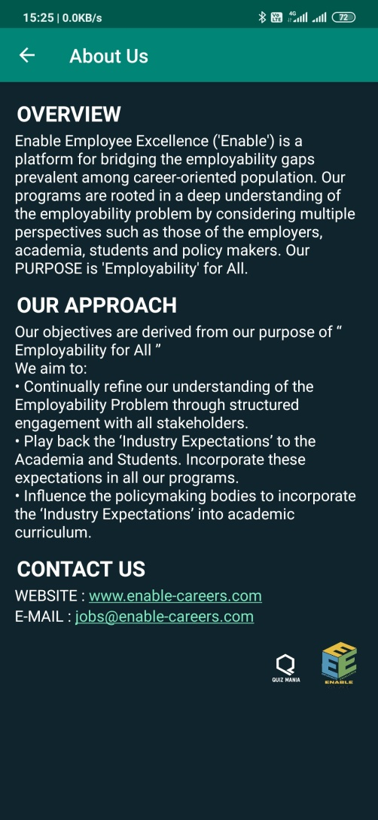
About Us
This is the about us page for the admin where he/she can find all the details about the company.

Slide 26
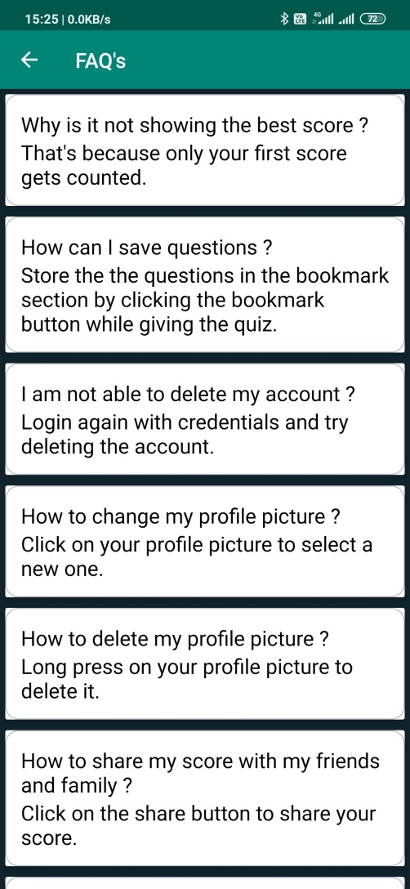
FAQ’s
These are the Frequently Asked Questions to help Users to clear some of his/her doubts regarding the features of the app.

Slide 27
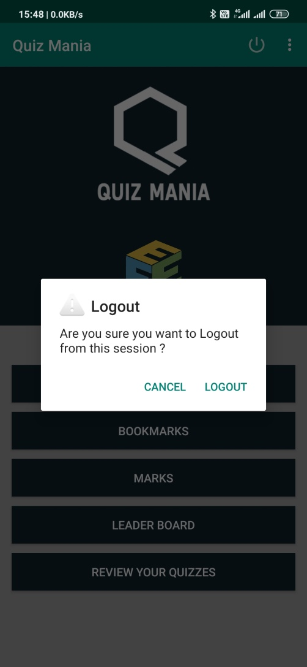
LOGOUT
User can logout of the application by simply clicking the logout button situated at the top right corner of the homepage.

